Slide 1
✍️HYBRID-POWERED ENGINE
_Sanjana Kashyap_
🎬Movie Recommendation System
A concise roadmap for building a movie recommendation system covering data, models, pipeline, evaluation, and deployment. KEY POINT:- Deliver personalized, scalable recommendations with robust evaluation and real-time serving. Emphasis on modular pipeline and production considerations.

Slide 2
⚠️PROBLEM STATEMENT & SOLUTION ✅
Problem Statement:-
With the rapid growth of online movie platforms such as Netflix and Amazon Prime Video, users face difficulty in finding movies that match their interests due to the huge amount of available content.
Major Problems:-
Too many movie choices (information overload)
Difficult to discover relevant movies
Time-consuming manual searching
Generic recommendations may not match user preferences
Proposed Solution:-
Develop a Hybrid Movie Recommendation System that combines content-based filtering with collaborative filtering to recommend movies matching both a movie’s content and a user’s personal taste.
Our Solution:-
Analyze movie features: title, genres, overview, keywords, cast, and crew.
Use vectorization (CountVectorizer) to convert content features into numerical format
Apply cosine similarity for content matching, and matrix factorization (SVD) on user ratings for collaborative filtering
Blend both scores with a weighted hybrid formula to recommend top 5 movies instantly

Slide 3
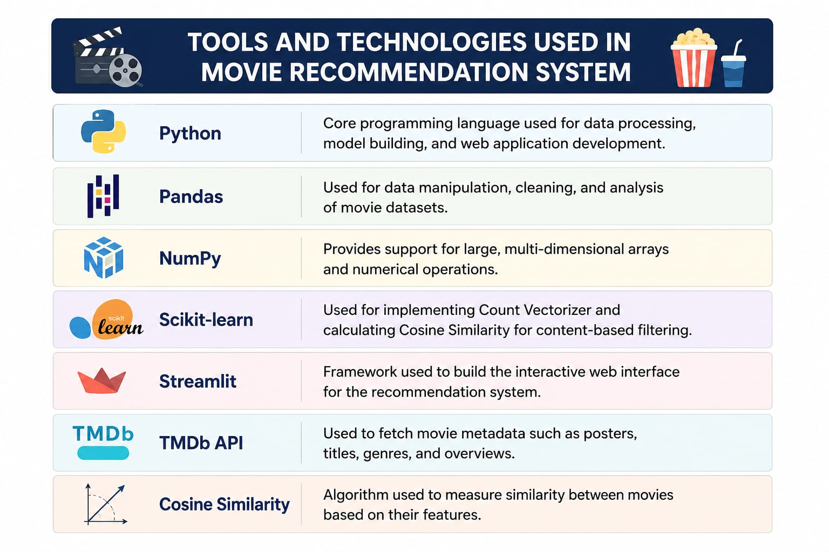
🛠️TOOLS $ TECHNOLOGIES USED
Core programming language used for data processing, model building, and web application development.
Used for data manipulation, cleaning, and analysis of movie datasets.
Provides support for large, multi-dimensional arrays and numerical operations.
Framework used to build the interactive web interface for the recommendation system.
Used for Count Vectorizer, Cosine Similarity, and SVD-based matrix factorization powering the hybrid model.
Used to fetch movie metadata such as posters, titles, genres, and overviews.
Content-based algorithm used to measure similarity between movies based on their features.

Slide 4







SYSTEM ARCHITECTURE
Data Collection
Movies + user ratings
Data Cleaning
Merge & clean fields
Feature Extraction
Tags from metadata
Vectorization
Count Vectorizer
Dual Scoring
Content + Collaborative
Hybrid Fusion
Weighted top-5 output
A hybrid pipeline: content-based similarity and collaborative filtering run in parallel, then blend into a single weighted score — giving more accurate, personalized recommendations.

Slide 5




DATASET DESCRIPTION
Content Metadata (TMDB)
Key Columns Used
Source: TMDB 5000 Movie Dataset (Kaggle)
Two files: movies.csv and credits.csv, merged on movie title
≈ 5,000 movies with rich metadata
Combined to build a single 'tags' feature per movie
title — movie name
genres — Action, Drama, Comedy, etc.
overview — short plot summary
keywords — theme-related tags
cast — lead actors
crew — director & key crew members
userId / rating — powers the collaborative side
Ratings Data (Collaborative)
ratings.csv — userId, movieId, rating
Builds the user-item matrix for collaborative filtering
tags = "action space war epic hero alien science-fiction leonardo dicaprio christopher nolan"

Slide 6



DATA PREPROCESSING
Cleaning Steps
Building the 'Tags' Column
Remove null and duplicate records
Convert stringified lists (genres, keywords, cast, crew) into Python lists
Keep only top 3 cast members and the director from crew
Remove spaces inside names so 'Sam Worthington' stays one token
Drop irrelevant columns (budget, revenue, language) not needed for content matching
Merge title, overview, genres, keywords, cast and crew into one 'tags' column
Convert tags to lowercase
Apply stemming (PorterStemmer) to reduce words to root form
Result: one clean text field per movie, ready for vectorization
Final dataframe kept to just movie_id, title and tags
Clean, consistent text input is what makes the similarity scoring in later stages accurate and reliable.

Slide 7



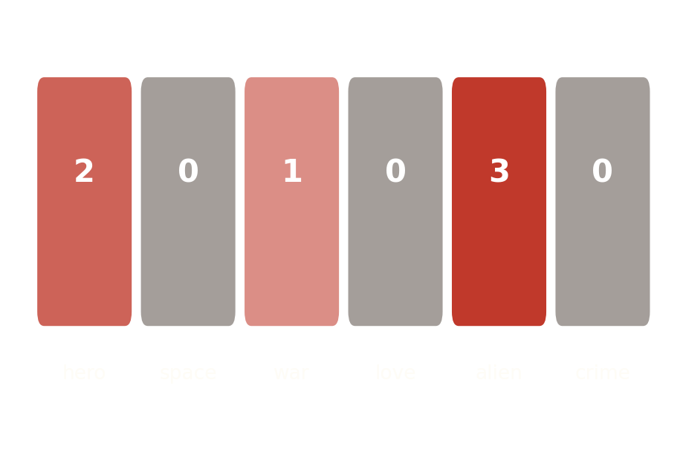
FEATURE ENGINEERING
Why Vectorization?
How It Works
Text can't be compared directly — it must become numbers
CountVectorizer converts each movie's tags into a word-frequency vector
max_features = 5000 keeps only the most informative words
English stop words (the, is, and…) are removed automatically
Every movie becomes a point in 5000-dimensional space
Similar movies end up with similar vectors
Output: a movie-count matrix used for similarity scoring
Forms the foundation for the recommendation engine
Example Word-Count Vector

Slide 8

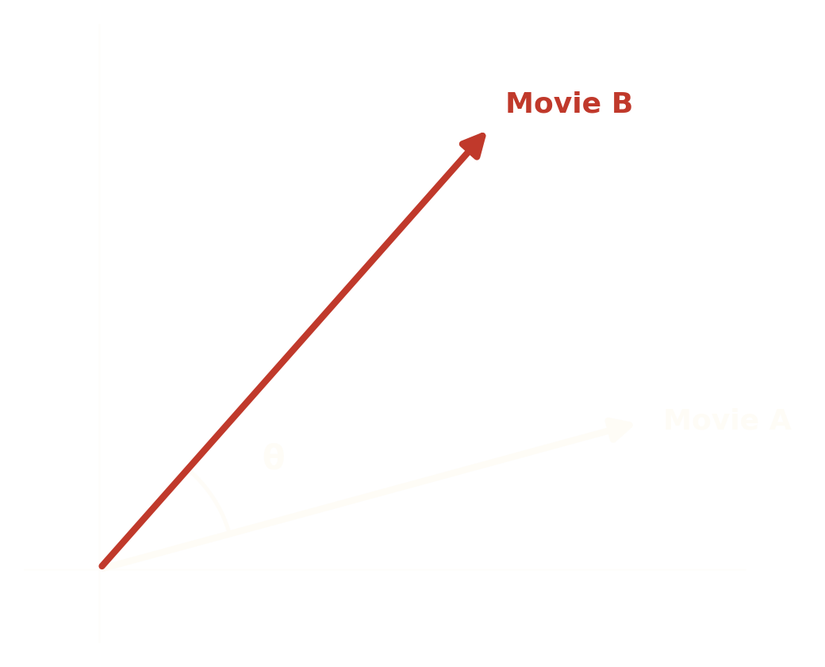


CONTENT-BASED SCORE
Concept
Measures the angle between two movie vectors, not their length
Score ranges from 0 (completely different) to 1 (identical)
A smaller angle between vectors means higher similarity
This is component 1 of the hybrid model — paired with collaborative filtering next
similarity(A,B) = (A·B) / (∥A∥×∥B∥)
Computed for every movie pair → scores sorted in descending order → top 5 highest-scoring movies (excluding the selected one) become the recommendations.

Slide 9
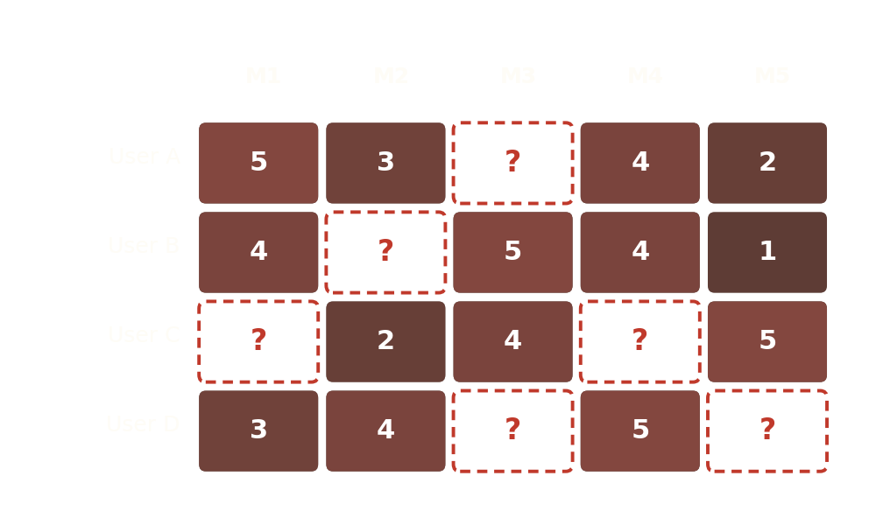
COLLABORATIVE SCORE
Concept
Builds a user-item ratings matrix — rows are users, columns are movies
Learns hidden ('latent') taste factors using matrix factorization (SVD)
Predicts the rating a user would likely give to an unseen movie
Finds patterns from real user behavior that metadata alone can't reveal
This is component 2 of the hybrid model, run alongside the content-based score
'?' cells are the ratings SVD predicts — the movie with the highest predicted rating is recommended.

Slide 10

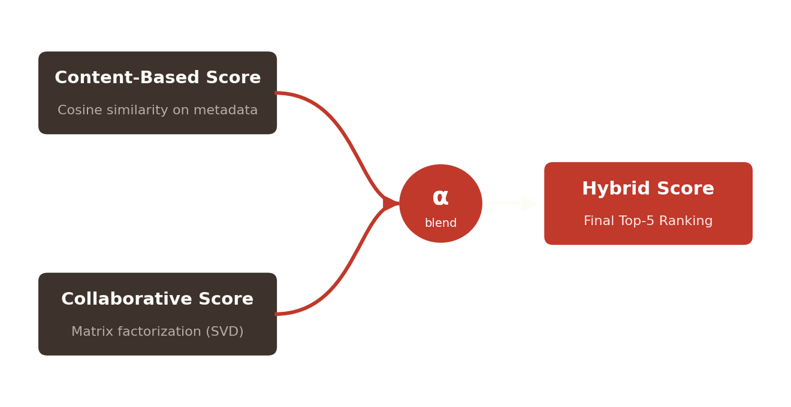

HYBRID FUSION STRATEGY
How the Two Scores Are Blended
final_score = α × content_score + (1 − α) × collaborative_score
α is tunable: weighted higher toward content-based for new users/movies (cold start)
Weighted higher toward collaborative filtering once enough ratings exist
Final list is re-sorted by the blended score — top 5 movies are recommended

Slide 11




RECOMMENDATION WORKFLOW
User Selects a Movie
from the dropdown list
Content-Based Score
cosine similarity
Collaborative Score
SVD prediction
Hybrid Fusion
weighted blend
Display Top 5
posters via API
Runs end-to-end in real time inside the Streamlit app — no page reloads or waiting
Both scores are precomputed and cached, so lookups stay fast even as usage grows
Same workflow scales to any dataset size with no logic changes

Slide 12



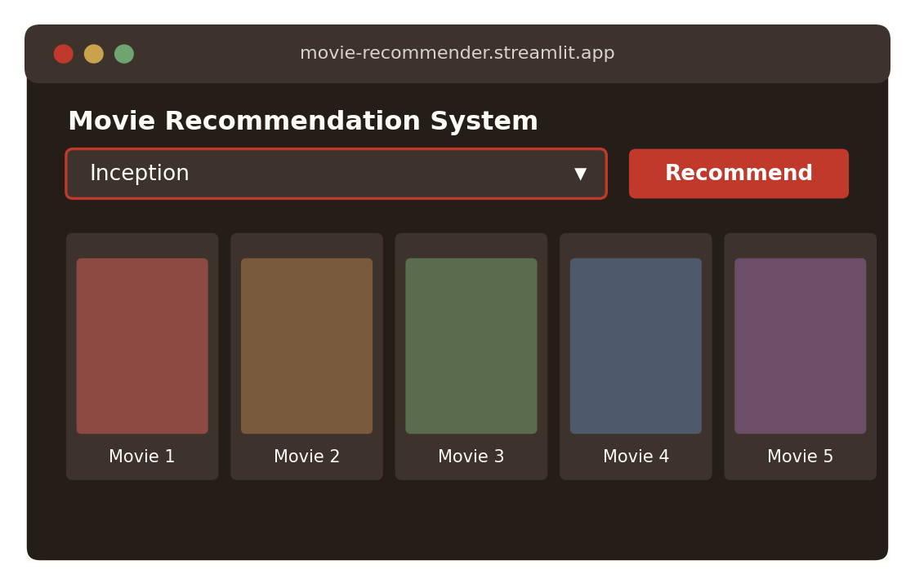
WEB APPLICATION
App Features
Under the Hood
Built with Streamlit for a fast, interactive UI
Dropdown lets users search and select any movie
'Recommend' button triggers similarity lookup
Displays top 5 movies as poster cards with titles
Precomputed content + collaborative scores stored using Pickle
TMDB API fetches live poster images and metadata
Deployable free on Streamlit Cloud
Responsive layout — desktop and mobile both

Slide 13



ADVANTAGES & LIMITATIONS
Advantages
Limitations
Solves cold-start better than pure collaborative filtering — new movies still get a content score
More personalized than pure content-based — learns individual taste from ratings
Balances metadata similarity with real user behavior
Blending weight (α) is tunable to the use case
Generally more accurate than either method used alone
Needs both movie metadata and user rating data to work well
More complex to build, tune, and maintain than a single-method system
Still faces cold start for brand-new users with zero ratings
Matrix factorization needs enough ratings data to be reliable
Requires careful tuning of the blending weight α
Overall: the hybrid approach trades some simplicity for meaningfully better accuracy and personalization.

Slide 14



CONCLUSION & FUTURE SCOPE
Conclusion
Future Scope
Built a hybrid movie recommender combining content-based and collaborative filtering
Balances metadata similarity with real user rating patterns
Delivers more accurate, personalized top-5 recommendations
Deployed as an interactive Streamlit web app
Demonstrates a complete, production-style hybrid ML pipeline
Auto-tune the blending weight α using validation data
Explore deep learning-based hybrid models (neural collaborative filtering)
Incorporate implicit feedback — clicks, watch time, skips
Add user login for continuously evolving taste profiles
Deploy at scale with real-time rating updates

Slide 15

THANK YOU
Hybrid Movie Recommendation System — Content-Based + Collaborative Filtering
Sanjana Kashyap
Questions & Discussion Welcome

